Slide 1
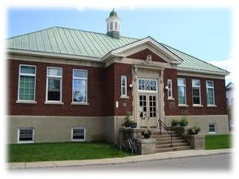
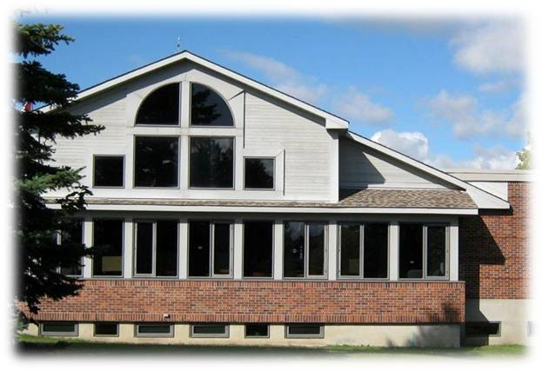
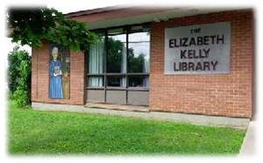
The Little Library That Could
Renfrew Public Library
Arnprior Public Library
OLA SuperConference Presentation
February 2, 2017
Mississippi Mills Public Library – Almonte Branch
Notes:
3 minutes slide during introductions

Slide 2
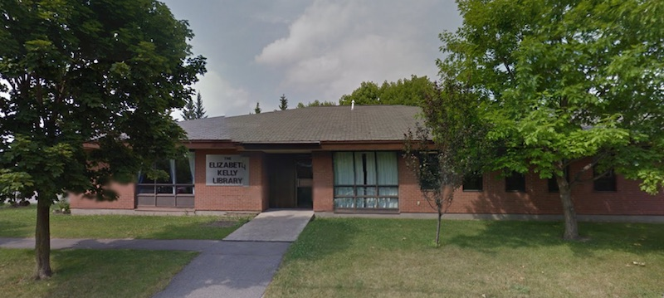
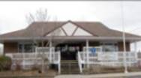
Mississippi Mills Public Library
Pakenham Branch
Currently under renovations
Almonte Branch
Population: 12,500
9,280 card holders (purge after 2 years)
Staffing: 1 full time (CEO)
7 part time employees; 2 casual/relief = 4FTE
Non-unionized
Total Annual circulation 2016: 155,482
Annual Circulation (books only): 117,656
DVDs, eResources etc. 37,826
Notes:
1.5 minutes
Pam to talk about her system

Slide 3
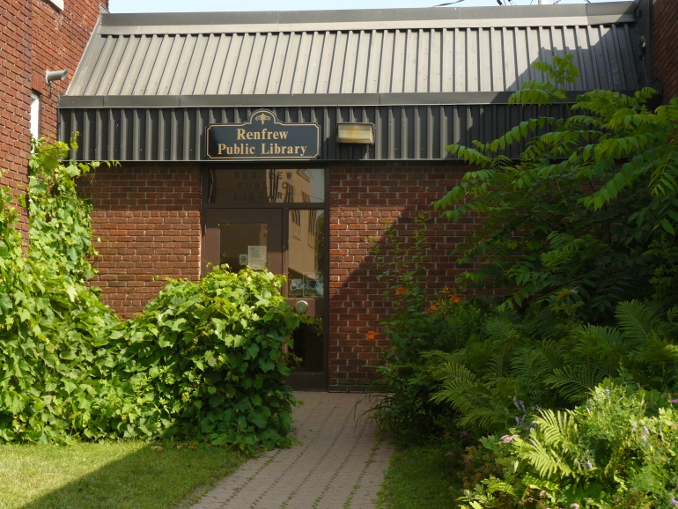
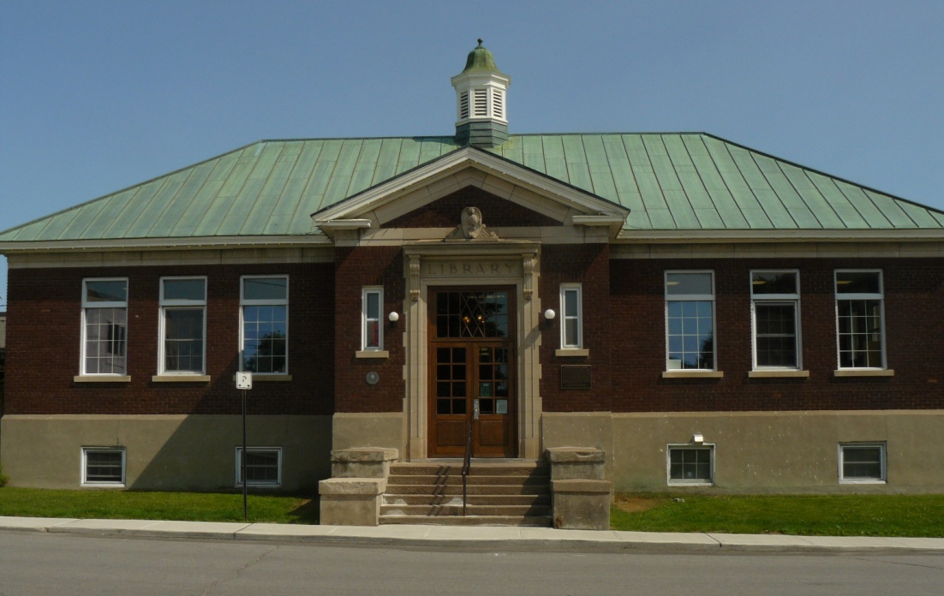
Renfrew Public Library
Population: 8,799
4741 patrons (purge after 2 years)
Staffing: 4 Full time
5 part-time 1.75 FTE
Unionized
Total Annual circulation 2016: 64,624
Annual circulation books only: 47,861
DVDs, eResources etc. : 16,763
Notes:
1.5 minutes
Kelly to talk about Renfrew

Slide 4
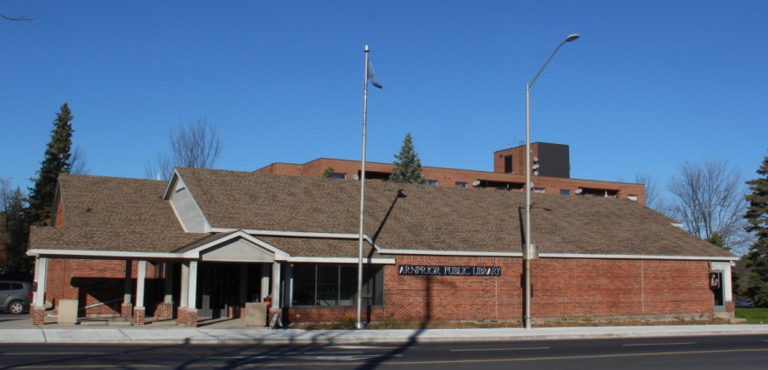
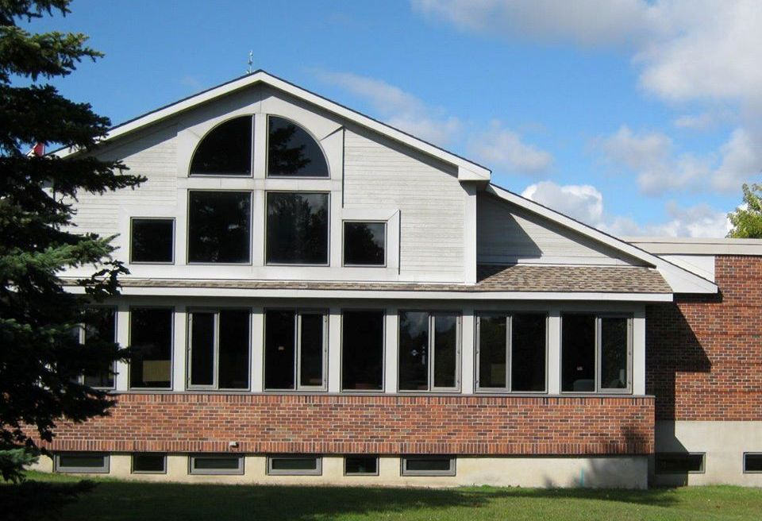
Arnprior Public Library
Population: 8,721
Contracting municipality: 7,589
5,160 patrons (purge after 18 months)
Staffing: 2 Full time - CEO & Children’s Services Librarian
8 part-time; 2 casual = 4.3 FTE
Non-unionized
Total Annual circulation 2016: 131,034
Annual circulation books only: 103,791
DVDs, eResources etc. : 27,243
Notes:
1.5 minutes
Karen to talk about Arnprior

Slide 5
Responsibility Snapshot
Administration; Board support
Financials (coding and tracking all expenses/payments, monthly reports, annual budget, reserves/investments, fundraising, petty cash, deposits); Grants
HR / Job descriptions / Pay equity
Renfrew - Union negotiations
Adult Programming
Arnprior (planning, execution, evaluation)
Renfrew - Overseeing all Programs and Services – Outcome based
Mississippi Mills – program oversight, planning – mostly lead/facilitate, do hands on programming occasionally or as required
Collection development / Weeding / ARPs and special orders
Marketing / Promotions / Newsletter
Outreach – planning, partnerships
Tech Support
Web site / social media
Building oversight
Notes:
3 Minutes
One of us to go through the list

Slide 6
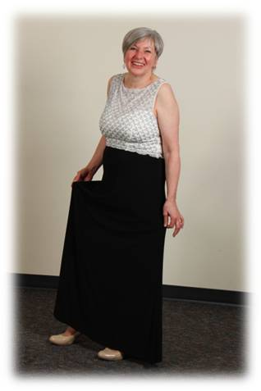
You’re officially a CEO of a small public library after …
- You had to remove all Kleenex from your office as an HR tactic
- You have stood ankle deep in a library flood
- You had to use a plunger at a library fundraiser . . .
while wearing a ball gown!
Used with permission
Notes:
.5 minute
Each of us gives our outrageous examples…
(giggles)

Slide 7
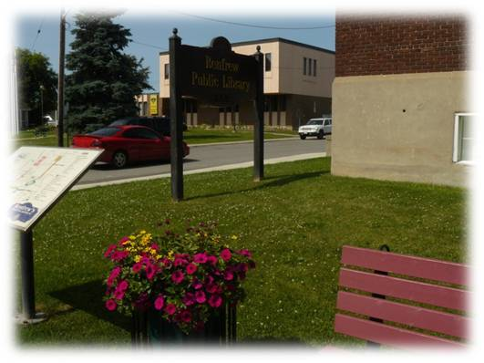
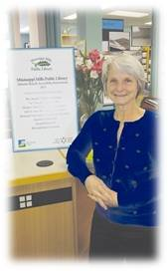
One person does it all
The Challenge
You fly by the seat of your pants
You never get caught up
The Advantage
You know every nook and cranny of the facility, its services and clientele
You have a good understanding of the needs in your community
You become a specialist on many fronts
(Technology, HR specialist, marketing, community support)
Notes:
2.5 minutes
Karen – overview of “One person does it all”

Slide 8
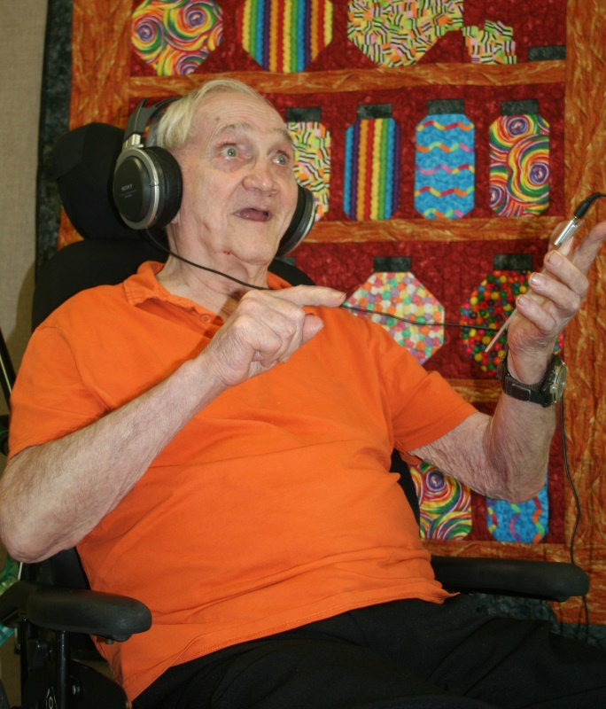
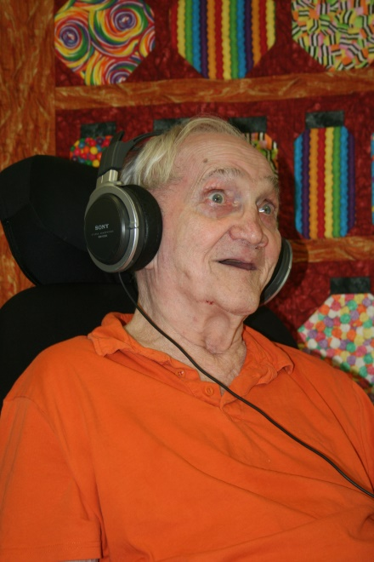
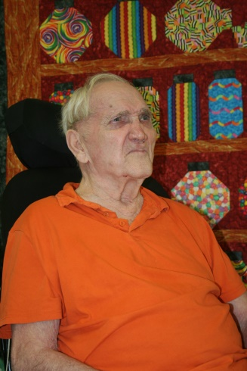
Successes on community front
Community buy-in for moveable shelving project leading to successful fundraising efforts on an ongoing basis
Fashion Shows | Author visits | Concerts | Art Exhibits
Proven track record helped to launch fundraising for iPod Project
Notes:
3 minutes
Karen
Because you are the face of the library - harness that insight of your community; contact the key players; work in concert with them and start creating!
Fortunate to have reserves to kickstart the moveable shelving project – create momentum to get buy-in from community groups / individuals.
Set your goal.
Maintain a focussed, clear path and rationalize your every step
Community buys in when they see progress

Slide 9
Successes on community front
Building Connections being out in the community
- attend local events from festival to music hall, craft fairs to openings, be there! - participate in local business breakfasts. Take the opportunity to talk up library events - attend municipal happenings: open houses, focus groups
Create new collections!
- seed library which grew to include lecture series, workshops, partnerships, participation in Seedy Saturday 2 years running and we will be partnering to build a community oven this spring/summer - music instrument lending library resulted in school partnership - disc golf!
Notes:
3 mintues
Pam –
Success of seed library / music collection – community buy-in

Slide 10
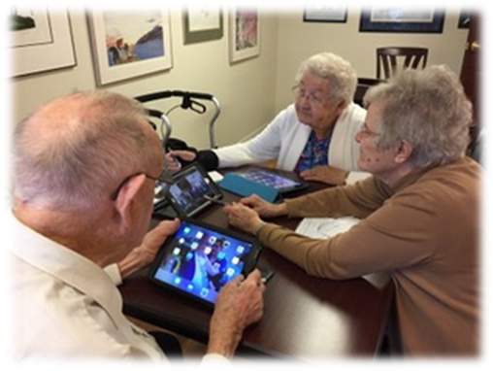
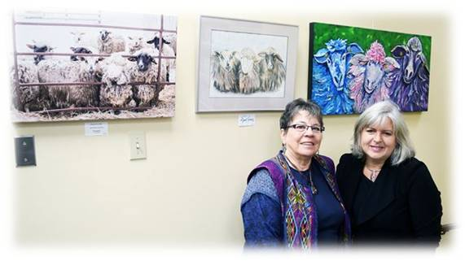
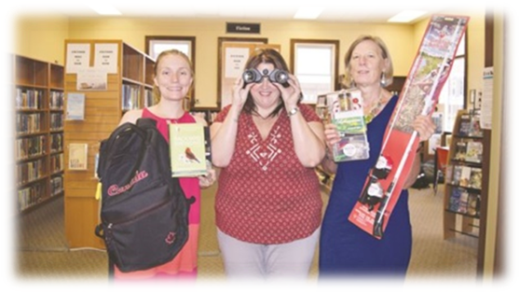
Successes on community front
More community integration occurs
Able to find (and fill) gaps
People start coming to YOU before you can get to them
Become a PART of the community
Equipment lending (including bicycles) – brings in different demographics
Outreach – Seniors residences, hospitals
Courtesy of Renfrew Mercury
Notes:
3 minutes Kelly
successes in restructuring an existing institution by introducing new programming
One person has the vision – redesign the space; invite community to celebrate (art exhibits)

Slide 11
Small Town Politics
The Challenge
Where do libraries fit in?
Constant justification for our services
“Hey look at me too”
Board development / profile
The Advantage
Word of mouth spreads quickly among supporters – use that support to have them lobby on behalf of the library. Politicians listen to the ratepayers!
Notes:
2.5 minutes
Kelly to overview

Slide 12
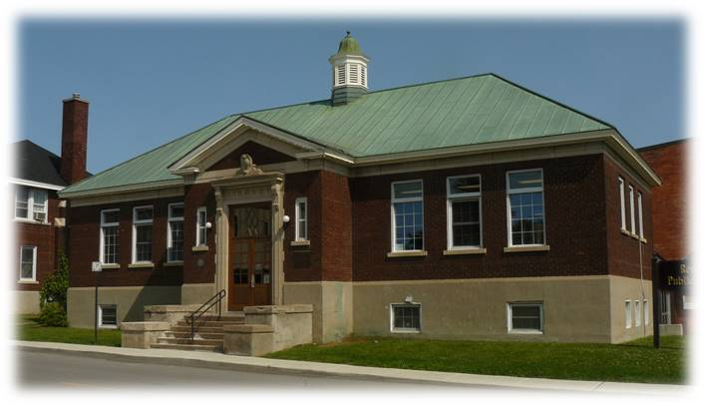
Successes on political front
Successful partnerships with Recreation / Tourism / Economic Development
Began to be a “talking point” in the community
Presentations to Council leads to better understanding
Don’t stop talking! Keep showing up!
Notes:
3 minutes
Kelly

Slide 13
Successes on political front
Small Acts, Big Impact
- attend council meetings regularly! - make sure council is updated often outside of council meetings - get yourself to "department head" meetings - inclusion on the municipal strategic planning process - community petition in response to budget constraints
Notes:
3 minutes
Pam

Slide 14
Successes on political front
Community rallied after lack of service agreement
Small community = greater interest in soft service
Became an election issue with Library Services ranked even higher than Recreation!
Attend Municipal Senior Management Team Meetings
Send eNewsletters to Councils
Invite politicians to events
Social Media
Notes:
3 minutes
Karen

Slide 15
Show me the money
The Challenge
Funding models
Service contracts
Competition for funds
Training
Notes:
2.5 minutes
Pam

Slide 16
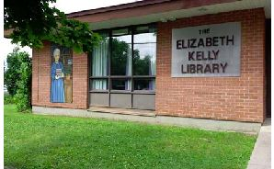
Financial successes
Grant applications and/or shared resources especially partnered:
- Industry Canada youth internship with Lanark County Public Libraries
- One Book, One Community with Lanark County public Libraries
- early literacy tutoring with CROW and Lanark County Public Libraries - Canada 150 grant for Pakenham Expansion with the Municipality, real team project
- partnered with the Mississippi Mills Youth Centre to
bring a fundraising Book Sale
Notes:
3 minutes
Pam

Slide 17
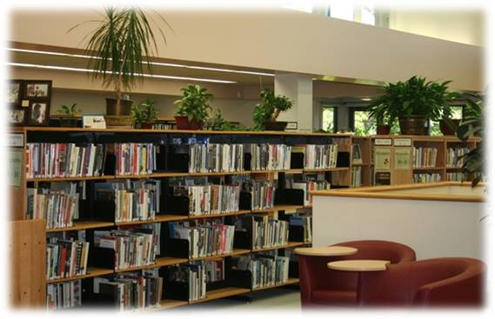
Financial successes
Success in fundraising
Grants for renovations; community fundraising (moveable shelves; collections; donor wall)
Bequests and trusts
Control of reserves (investment policy)
Inclusion: energy audit; security audit
Ensuring library receives
ongoing funding via Development Charge By-law review
Notes:
3 minutes Karen

Slide 18
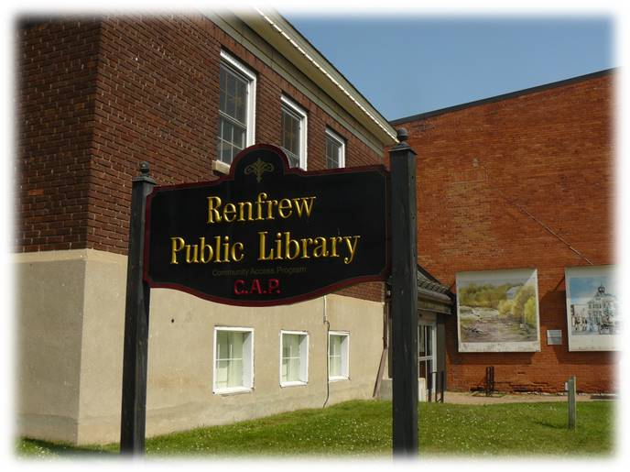
Financial successes
Funding new outreach position
Budget issues on the table
Building issues being addressed
Part of development charges study
Part of building assessment study
Notes:
3 minutes
Kelly

Slide 19
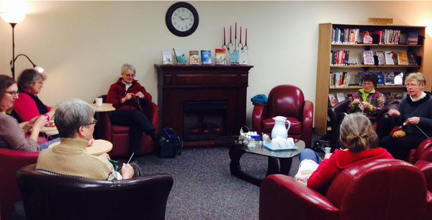
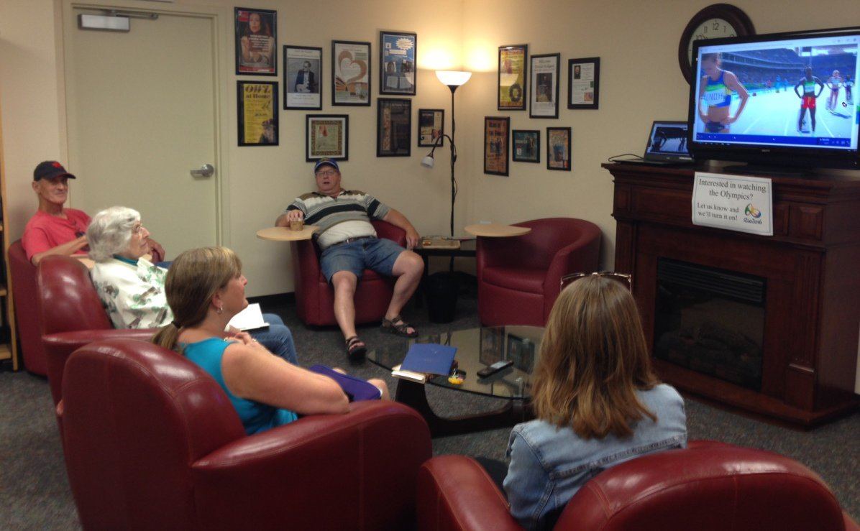
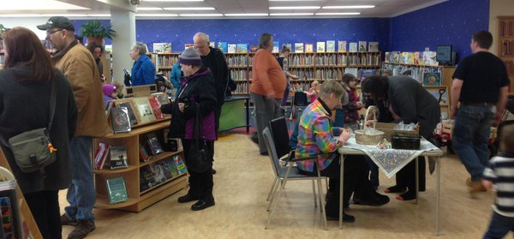
Get the word out
The Challenge
Making the case for library services
The Response
Show up!
Be visible!
Notes:
2.5 minutes Karen

Slide 20
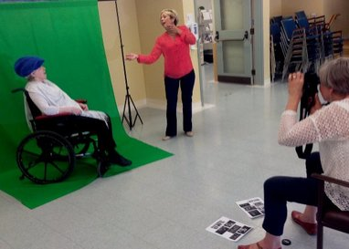
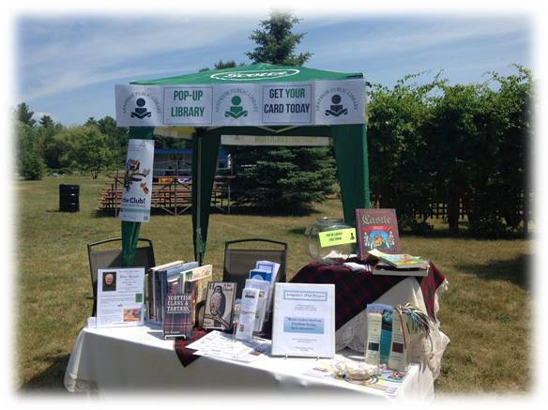
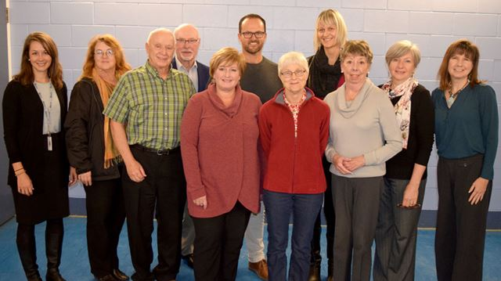
Get the word out in Arnprior
Monthly eNewsletter (and hard copy at circulation desk)
Repurpose computers for kiosk displays
Outreach –
Senior’s residences (green screen)
Pop-up library
Join organizations
Invite the community to participate
Newspaper column(s); specialty magazines
Social media – with photos
Take photos for ongoing promotions!
Notes:
3 minutes
Karen

Slide 21
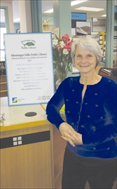
Get the word out in Mississippi Mills
Quarterly newsletter
Regular submission to local papers and online papers "what's happening?“
Speaking Volumes/Humm - a shared rotation between Renfrew, Arnprior and Lanark County/Smith Falls libraries mini electronic picture frames at each service desk soon to be expanded to large screen TV
Partnerships e.g. with Mill Street Books brought us the governor general and the Mississippi Valley Textile Museum increased programming
Notes:
3 minutes
Pam

Slide 22
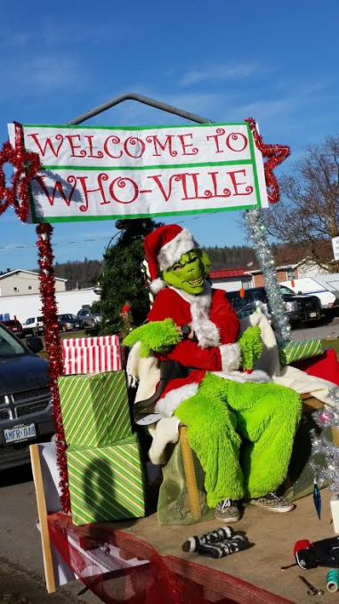
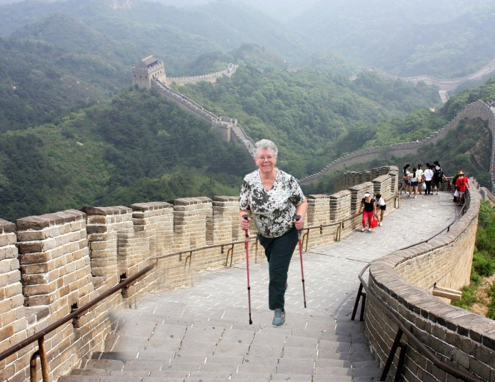
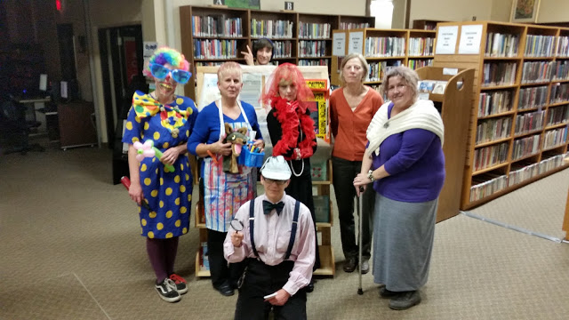
Get the word out in Renfrew
Outreach is key
Go where people are! Storytime in Park, Storytime Trail (Petawawa)
Local newspapers, radio stations
Social media is a key!
Newcomers nights, church groups, seniors activity centres, Rotary…find out where people are in your community and go there!
Trivia nights…use programs as marketing opportunities
Notes:
3 minutes
Kelly

Slide 23
Questions
Kelly Thompson
Renfrew Public Library
613.432.8151
kthompson@renfrew.library.on.ca
Pam Harris
Mississippi Mills Public Library
613.256.1037
pharris@mississippimills.ca
Karen DeLuca
Arnprior Public Library
613.623.2279
karen@arnpriorlibrary.ca
Notes:
15 minutes

